Slide 1
Lab 5
Web Scraping

Slide 2
What is Web Scraping?
Web Scraping is the practice of extracting data from websites
Getting data from an HTML file and parsing it in Python to then get data
For example, in Project 3 we will scrape Craigslist for Apartment Prices

Slide 3
Why is Web Scraping Useful?
Can extract necessary data in a timely manner
Think about getting all Apartment Prices on Craigslist by hand vs. having a program (code) do that for you!
Extracted data can be used to help you answer questions
ex) If you are thinking of living off-campus and want to know: what is the average price of all apartments in Providence?
Can create Data Visualizations with extracted data!
ex) A graph of the change in avg. apartment price as you have more bedrooms

Slide 4
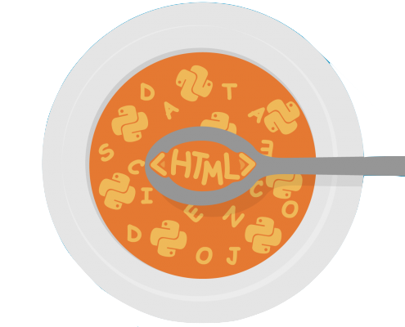
Web Scraping in Python
Process
Go through the HTML code of a website (inspect tool)
Determine what tags/text contains desired data
Convert HTML page into Python (BeautifulSoup parser!)
Extract necessary data using BeautifulSoup methods
Format data in a usable data structure!
Take a look at the lecture notes on Web Scraping! It has an example w/ code!

Slide 5
Lab Assignment
For this Lab Assignment, you will be looking at the Brown Academic Calendar and scraping for all of the event names and dates. You will create a dictionary where the KEY is the date and the VALUE is the event name.
Step 1: Get the data (Done for you in the stencil code)
Step 2: Parse the data
Step 3: Extract Information

